Slide 1
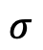
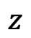
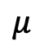
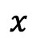
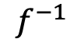
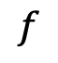
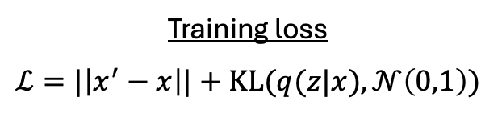
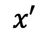
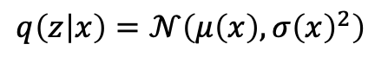
$$f$$
$$f^{−1}$$
Encoder
Decoder
$$μ$$
$$σ$$
$$x$$
$$z$$
$$x′$$
Input data
Latent representation
Reconstruction
$$q\left(z | x\right)=𝒩\left(μ\left(x\right),{σ\left(x\right)}^{2}\right)$$
Training loss
$$ℒ=|\left|x^{′}−x\right||+KL(q(z|x), 𝒩\left(0,1\right))$$

Slide 2
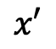
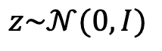
Generator, G
Discriminator, D
$$z\sim 𝒩(0, I)$$
$$x′$$
✓/✗
Random
Latent sample
Generated
data
Real data?

Slide 3
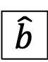
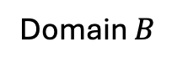
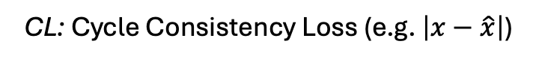
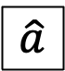
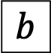

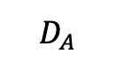
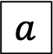
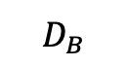
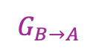
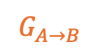
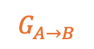
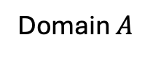
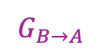
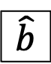
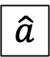
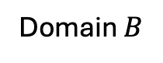
$$D_{B}$$
$$D_{A}$$
$$G_{A→B}$$
$$G_{B→A}$$
$$G_{B→A}$$
$$G_{A→B}$$
$$a$$
$$\hat{b}$$
$$\hat{a}$$
$$b$$
$$\hat{a}$$
$$\hat{b}$$
+
+
+
+
+
+
CL
CL
Domain $A$
Domain $B$
Domain $B$
Domain $A$
CL: Cycle Consistency Loss (e.g. $\left|x−\hat{x}\right|$)

Slide 4
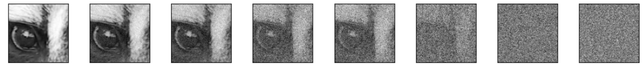
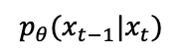
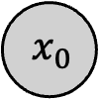
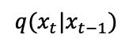
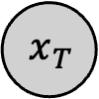
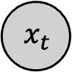
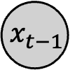
$$p_{θ}(x_{t−1}|x_{t})$$
$$x_{0}$$
. . .
$$x_{t−1}$$
$$x_{t}$$
. . .
$$x_{T}$$
$$q(x_{t}|x_{t−1})$$

Slide 5
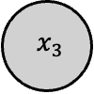
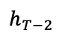
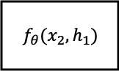
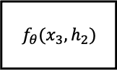
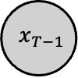
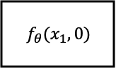
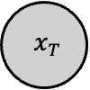
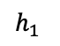
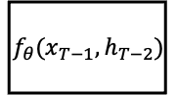
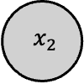
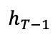
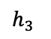
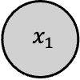
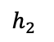
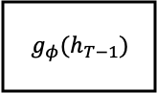
`
$$x_{T}$$
$$f_{θ}(x_{1},0)$$
$$h_{1}$$
$$f_{θ}(x_{2},h_{1})$$
$$h_{2}$$
$$f_{θ}(x_{3},h_{2})$$
$$h_{3}$$
. . .
$$h_{T−2}$$
$$f_{θ}(x_{T−1},h_{T−2})$$
$$h_{T−1}$$
$$g_{φ}(h_{T−1})$$
$$x_{1}$$
$$x_{2}$$
$$x_{3}$$
$$x_{T−1}$$

Slide 6
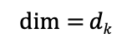







`
Today
it
looks
like
it
will
Today
it
looks
like
it
will
18449
480
8224
1299
480
738
18449
480
8224
1299
480
738
Embedding
dimension
= $dmodel$
$$K=HW_{K}$$
$$V=HW_{V}$$
Token
Label
$$H$$
Today
18449
a₁₁
a₁₁
a₁₃
a₁₄
a₁₅
a₁₆
it
480
a₂₁
a₂₂
a₂₃
a₂₄
a₂₅
a₂₆
looks
8224
a₃₁
a₃₂
a₃₃
a₃₄
a₃₅
a₃₆
X
p(“rain”) = 0.8
like
1299
a₄₁
a₄₂
a₄₃
a₄₄
a₄₅
a₄₆
p(“snow”) = 0.2
it
480
a₅₁
a₅₂
a₅₃
a₅₄
a₅₅
a₅₆
will
738
a₆₁
a₆₂
a₆₃
a₆₄
a₆₅
a₆₆
Feed-forward network
$$Q=HW_{Q}$$
$\dim{=}dk$
Embedding lookup
Attention Matrix = $SoftMax\left(\frac{QK^{T}}{\sqrt{d_{k}}}\right)$
$(\sum_{j}{a_{ij}=1})$
$$Att\left(Q,K,V\right)=\left(\frac{QK^{T}}{\sqrt{d_{k}}}\right)V$$

Slide 7



`
. . .
. . .
. . .
. . .
$$K=H_{im}W_{K}$$
$$V=H_{im}W_{V}$$
Token
Label
$$H$$
What
18449
a₁₁
a₁₁
a₁₃
a₁₄
…
a_{1p}
is
480
a₂₁
a₂₂
a₂₃
a₂₄
…
a_{2p}
the
8224
a₃₁
a₃₂
a₃₃
a₃₄
…
a_{3p}
X
p(“cloudy”) = 0.99
weather
1299
a₄₁
a₄₂
a₄₃
a₄₄
…
a_{4p}
p(“sunny”) = 0.01
like
480
a₅₁
a₅₂
a₅₃
a₅₄
…
a_{5p}
today
738
a₆₁
a₆₂
a₆₃
a₆₄
…
a_{6p}
Feed-forward network
$$Q=HW_{Q}$$
$\dim{=}dk$
Embedding lookup
Attention Matrix = $SoftMax\left(\frac{QK^{T}}{\sqrt{d_{k}}}\right)$
$(\sum_{j}{a_{ij}=1})$
$$Att\left(Q,K,V\right)=\left(\frac{QK^{T}}{\sqrt{d_{k}}}\right)V$$

